Slide 1



Sprocket Central Pty Ltd
Data analytics approach
By Islam Omar

Slide 2
Agenda
Introduction
Data Exploration
Model Development
Interpretation

Slide 3
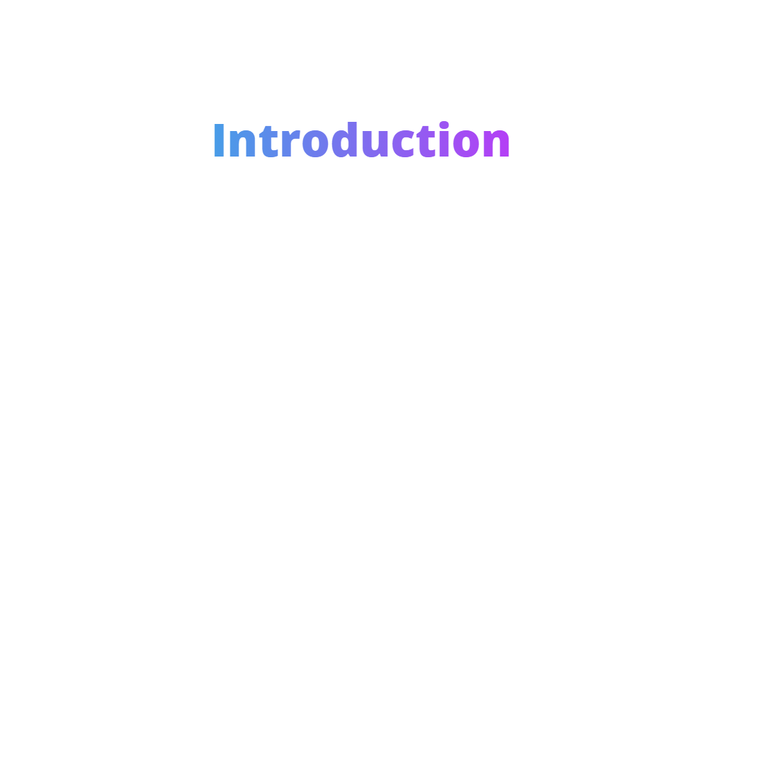
Sprocket Central Pty Ltd is a long-standing KPMG client who specializes in high-quality bikes and accessible cycling accessories to riders.
Their marketing team is looking to boost business by analyzing their existing customer dataset to determine customer trends and behavior.
Using the existing 3 datasets (Customer demographic, customer address and transactions) as a labelled dataset, I will present the approach of the whole analysis process of recommending the most valuable customers out of the new 1000 potential customers.

Slide 4
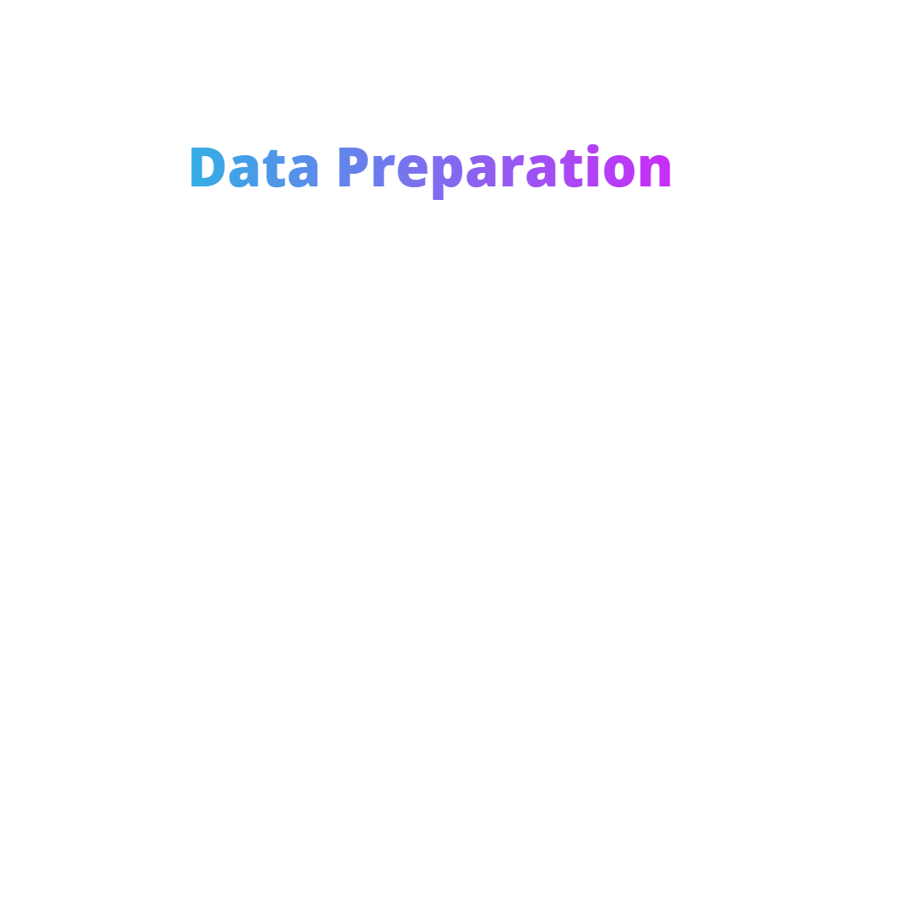

Slide 5
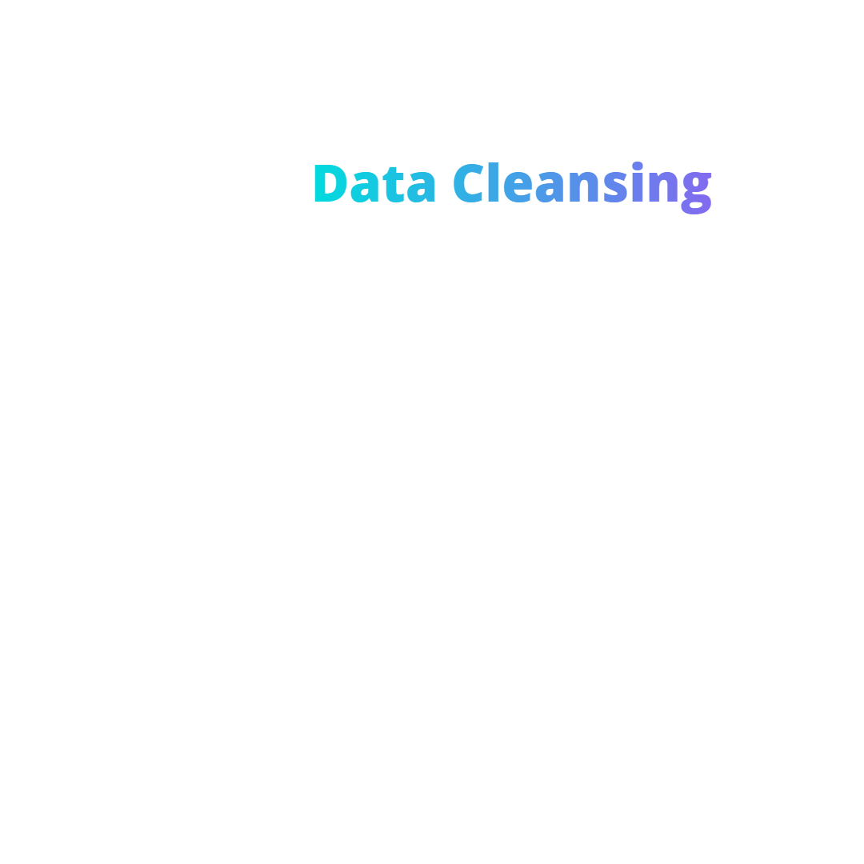
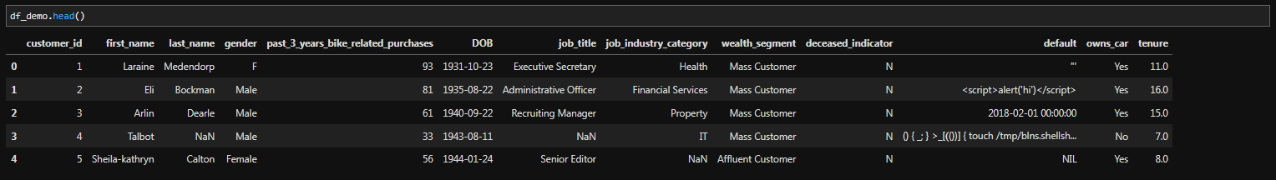
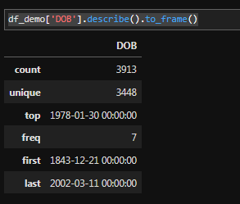
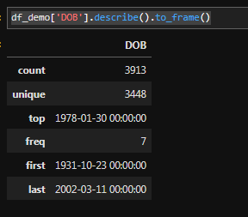

1.Dropping Insignificant Columns
Ex: defaults Column
2. Fixing Illogical Values
Ex: DOB value (1843-12-21) converted to (1943-12-21)

Slide 6


3. Values Standardization
Ex: In the gender column (F, Female, Femal) standardized to be (Female)

Slide 7
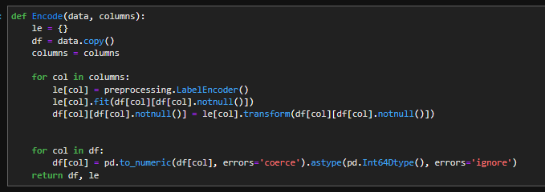
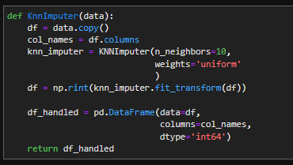
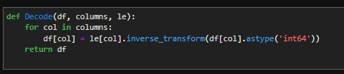
4. Handling Missing Values Using KNN Imputer Algorithm
A) Encode the values.
B) Use The KNN Imputer Algorithm to
impute the missing values.
C) Decode the values.
(A)
(B)
(C)

Slide 8
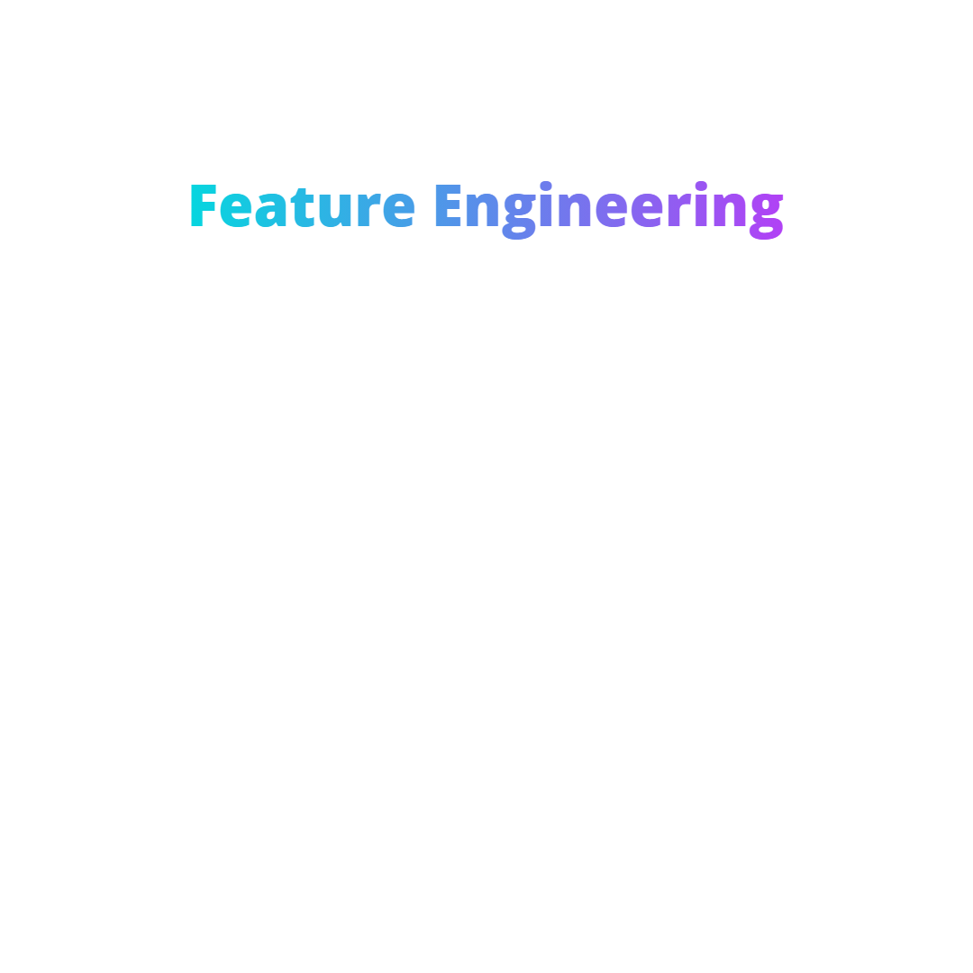
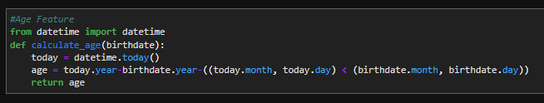
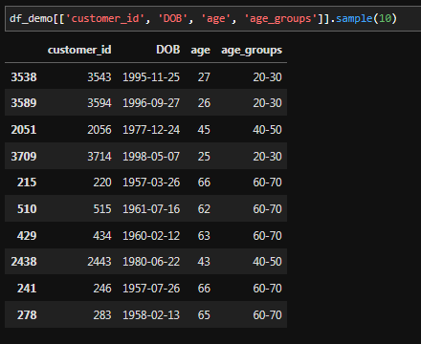

1. Creating Age Feature
Results
2. Creating Age Groups
Feature

Slide 9
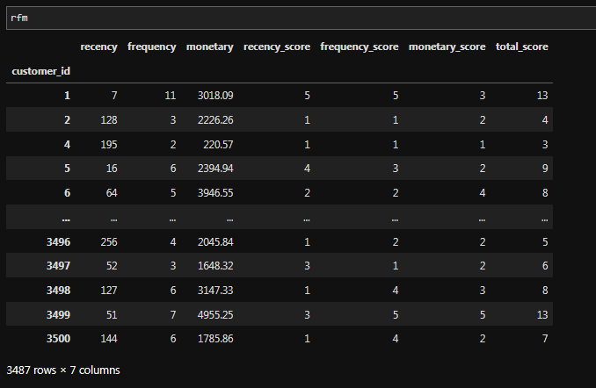

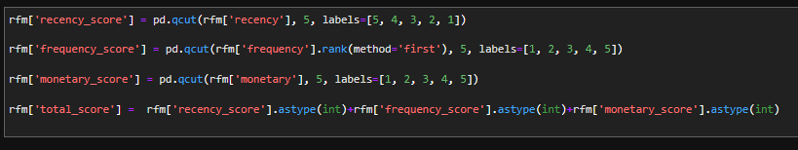
Results
3. Calculate RFM Values
4. Creating RFM Scores

Slide 10
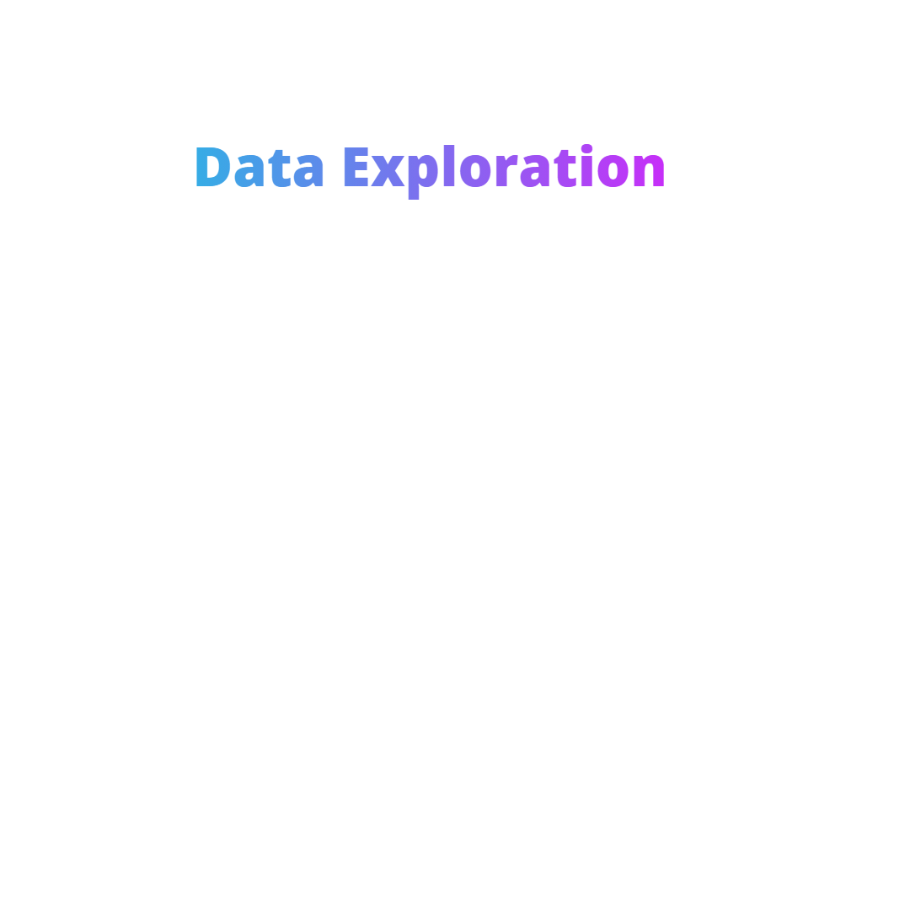

Slide 11
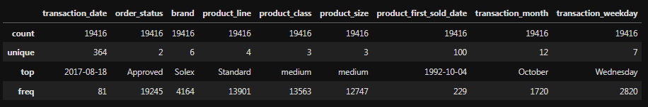
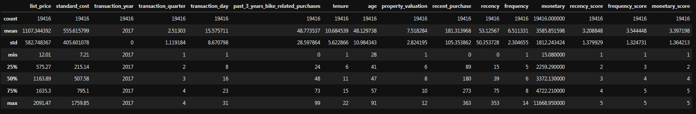
1. Basic Descriptive Statistics
Categorical Values Statistics
Numerical Values Statistics

Slide 12
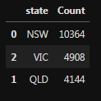
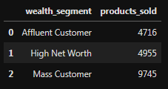
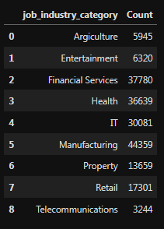
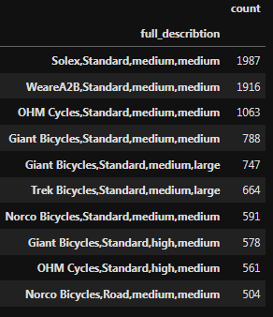
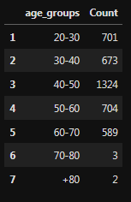
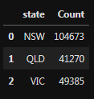
2. Frequency Tables
No. of Products Sold per State
No. of Products Sold per Wealth Segments
No. of Products Sold per Job Industry
Top 10 Selling Products
No. of Customers by Age Group
No. of Last 3 Years Bike related Purchases
per State

Slide 13
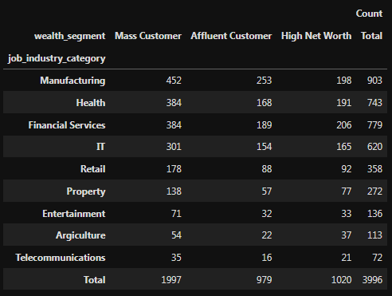
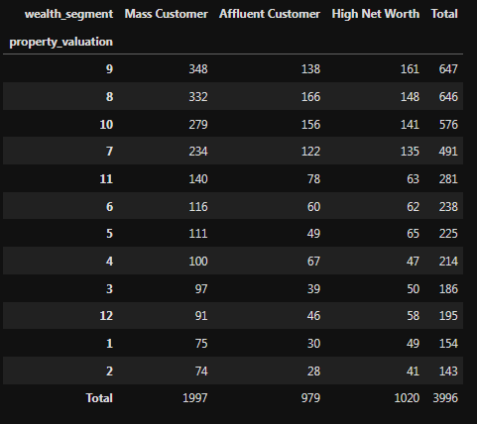
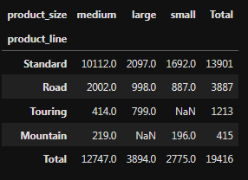
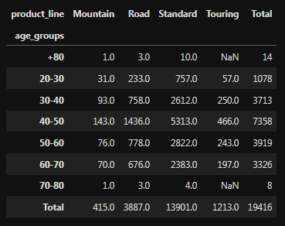
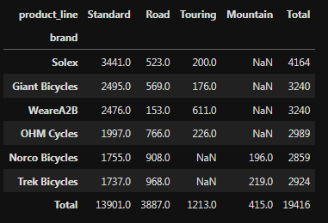
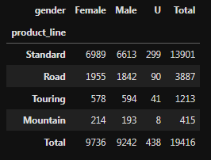
3. Contingency Tables
Distribution of Job Industries by Wealth Segments
Distribution of Property Valuation by Customer Segment
Distribution of Product Size by Product Line
Distribution of Age Groups by Product Line
Distribution of Brands by Product Line
Distribution of Product Line by Gender

Slide 14
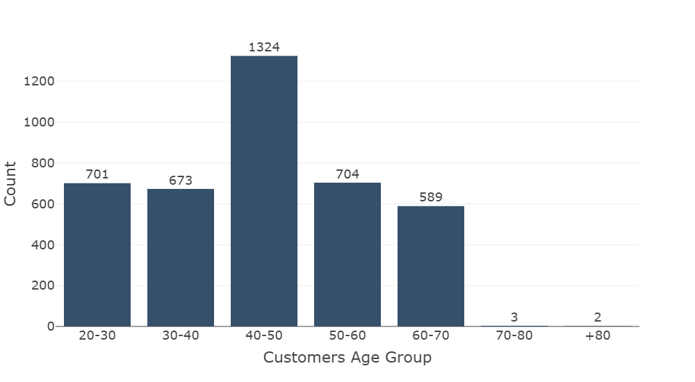
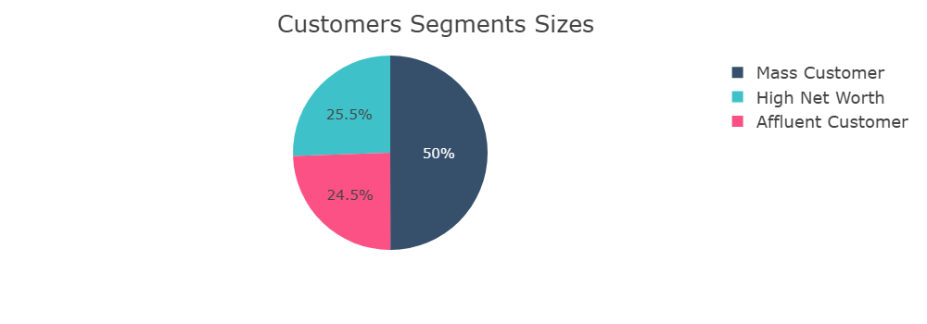
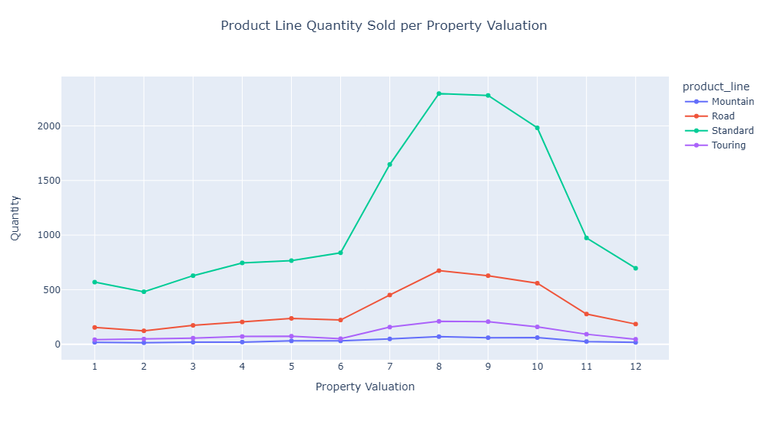
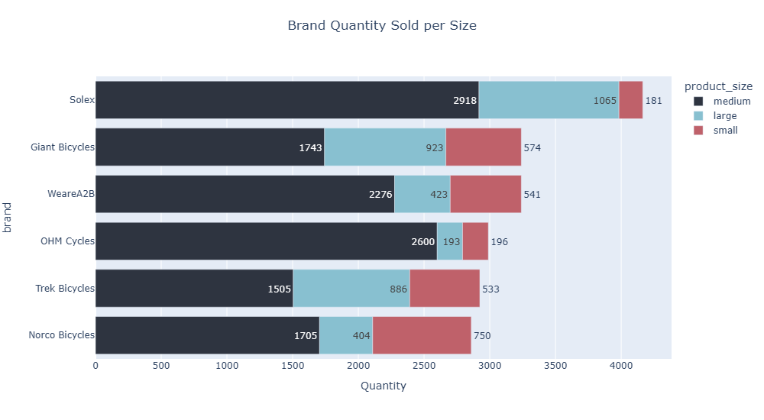
4. Visualizing The Tables

Slide 15
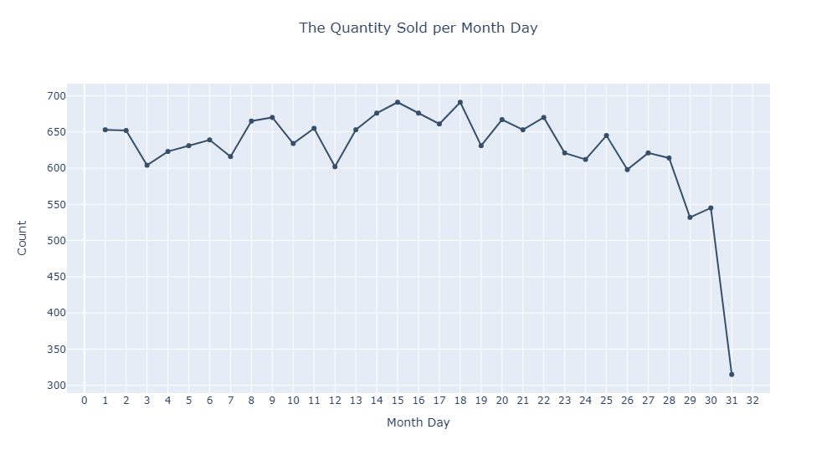
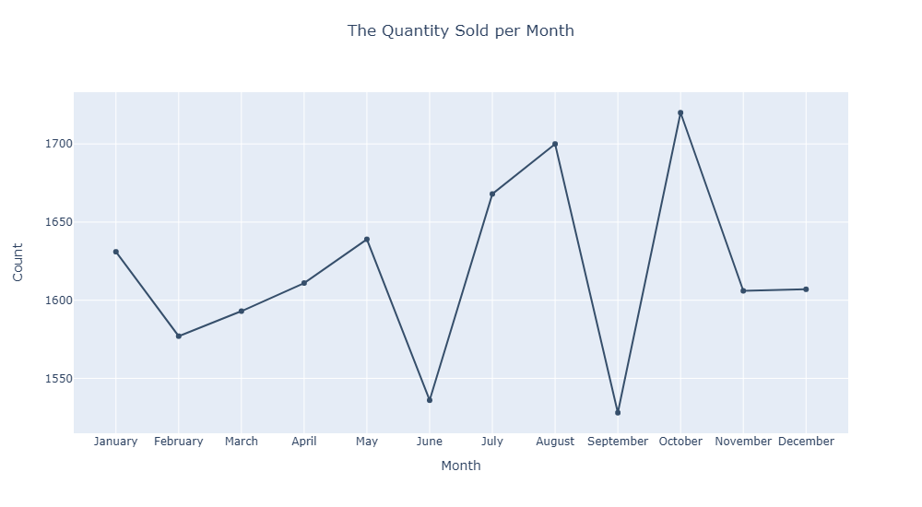
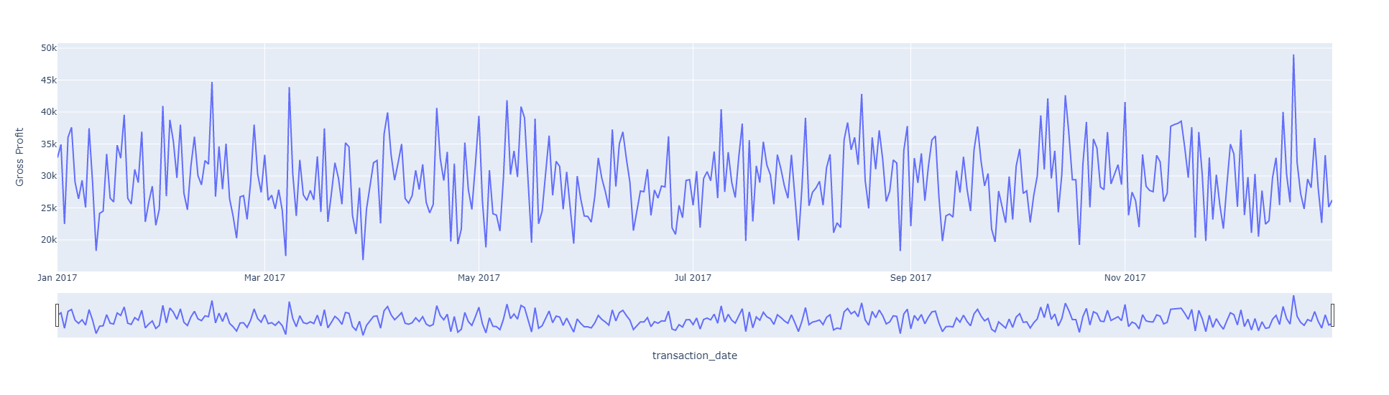
5. Time Series Analysis

Slide 16
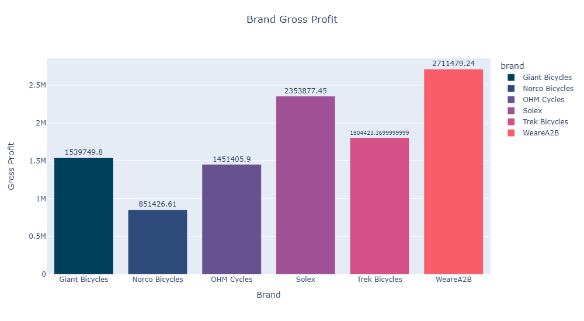
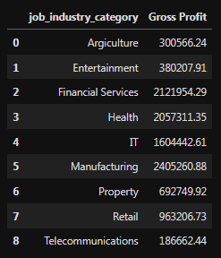
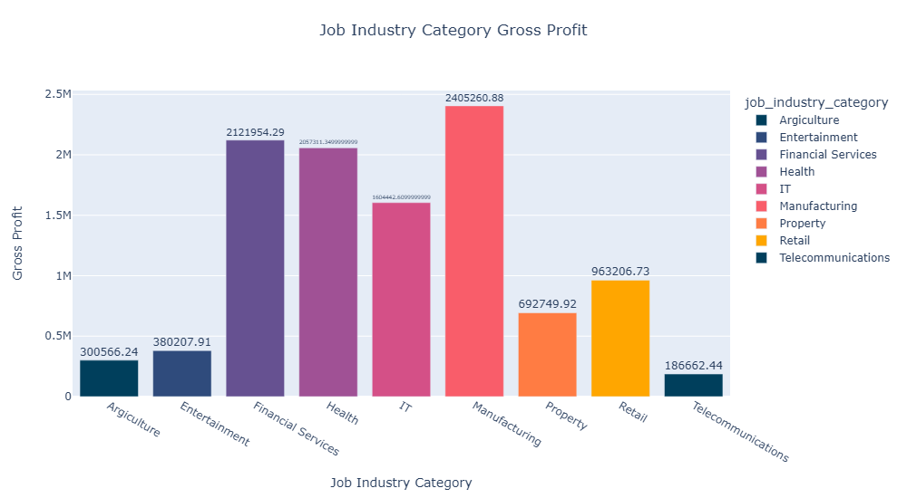
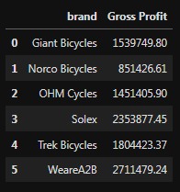
6. Profitability Analysis
Gross Profit for each Job Industry
Gross Profit for each Brand

Slide 17
Model Development

Slide 18
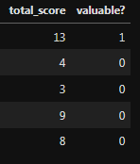
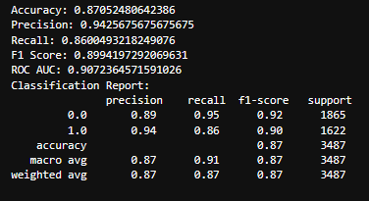
Model Development
Random Forest Classifier Algorithm has been used in the Model Development process.
Data Labeling:
The Customers have been labeled based on their Total RFM Score
The criteria was to label the Customer to be Valuable ”1” if his RFM Score is greater than or equal 10, Else, the customer will not be labeled as Valuable ”0”.
Feature Selection:
We Used RFE Algorithm to select the features that the model will be trained on.
Model Training:
To train the model, Firstly, We have encoded the data.
Then, We used GridSearchCV technique to find the optimal parameter values for the Random Forest Classifier Algorithm.
After finding the best parameters We trained the model on the data.
Evaluation Metrics
Model Evaluation:
At the end We Evaluated the Model to gain insights about its performance.

Slide 19
Interpretation

Slide 20
Interpretation
After We trained the Model, We used it to predict the valuable
customers from the 1000 New Customers.
The model have succeeded to recommend 456 valuable
customers out of the 1000 New Customers.

Slide 21
Thank You
You can find the full project on Github

